Slide 1

Making it Easy to Give Part 2:
Online Giving through the Presbyterian Foundation
Pittsburgh Presbytery – October 17, 2019

Slide 2
Online Giving Through the Presbyterian Foundation
Since November of 2017, the Presbyterian Foundation has used Vanco Payment Solutions as our platform for online giving.
Vanco Payment Solutions is a PCI Level 1Compliant Service Provider and meets all data security standards for handling, storage and transmitting credit card information.
Less expensive to go through the Presbyterian Foundation then through Vanco directly.
  No start up or recurring fee. Simply a 2% administrative fee per transaction. No need to negotiate with credit card vendors, merchant services, etc.
Easy two page application.
  Submit application and a copy of a voided check via email to onlineservices@presbyterianfoundation.org, fax or US mail
  Once received in our home office, your site will be live in 5-7 business days,

Slide 3
Administrative Details
The Presbyterian Foundation receives and receipts all gifts and payments.
  Can receive both gifts and fees for service. Your administrator(s) simply contacts online services to set up a fee for service fund and the foundation with receive it as such. Transactions that are fees for service do not show up on year end gift summary.
Administrators will receive credentials to be able to log in to monitor contributions/payments and run reports.
Your administrators are able to see gifts/payments made in real time. They will receive an email for all gifts and a daily summary report each day one or more gifts are made. (Emails for each transaction can be turned off.)
The last business day of each month income is transferred to church checking account on file.
  Administrators may request additional transfers up to once a week in increments of $100 or more.
The transaction will show up as made to your church or ministry on the donors bank or credit card statement.

Slide 4
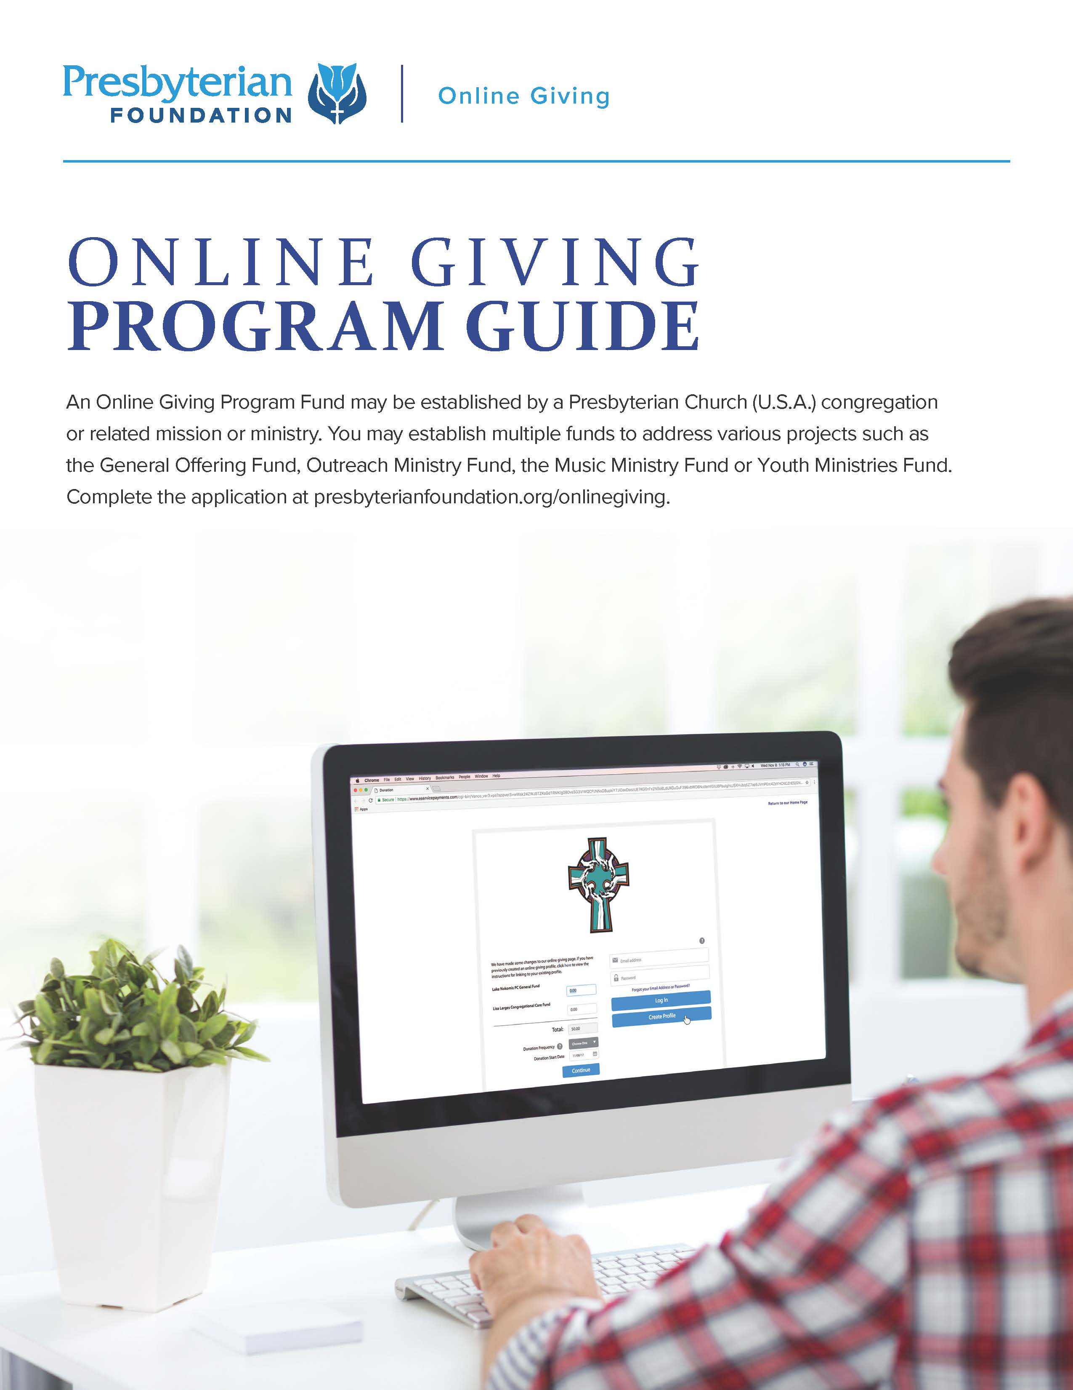
Online Giving Program Guide
Online Giving Program Guide
Review this piece for more information and how the Presbyterian Foundation can assist you in setting up an online giving program for your church.
Review this piece for more information and how the Presbyterian Foundation can assist you in setting up an online giving program for your church.

Slide 5
ONLINE FUND MANAGEMENT TOOLS ALLOW YOU TO:
Offer a mobile responsive donation form
Receive donations online or from a mobile device
Monitor contributions

Slide 6




Demo from the Donors Side
https://pbylakeerie.org/

Slide 7

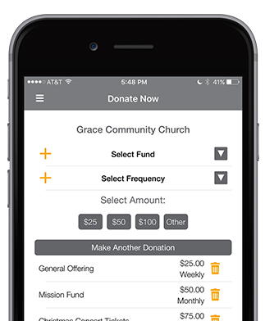


Boost Giving with the Convenience of Mobile
The GivePlus Mobile app allows anyone to give on their phone - wherever they are.
Supporting your church's mission is as easy as 1-2-3
With GivePlus Mobile your members and guests can express their generosity in the moment — right from the palm of their hand.
Download the app
Find your church
Give!
And best of all, GivePlus Mobile is included with ALL eGiving plans. That means you pay no additional set-up or monthly fees to offer the app.
Tell your donors to search for “GivePlus Church” to quickly find and download the app today!.

Slide 8

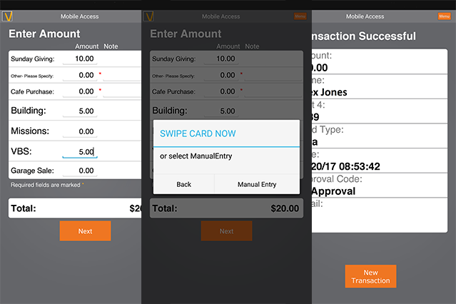
Whether you’re running a bake sale or selling tickets to an event, give your members and guests the flexibility to pay with the swipe of a card.
Download the free app, plug the card reader into your mobile device and you are ready to start collecting payments
Compatible with Apple and Android devices
Our encrypted card reader have been designed specifically for faith-based organizations
Contact Online Services to order the hardware for $45.
Standard 2% administrative fee applies on all transactions.

Slide 9
A Few Reminders…
Who are you targeting?
  Casual givers
Liturgical act of giving
  Get creative
Promotion is important
  Newsletter article
  See sample Pew Card
  Check out the Presbyterian Foundations Print Services for more resources – save pdf or order printed items

Slide 10
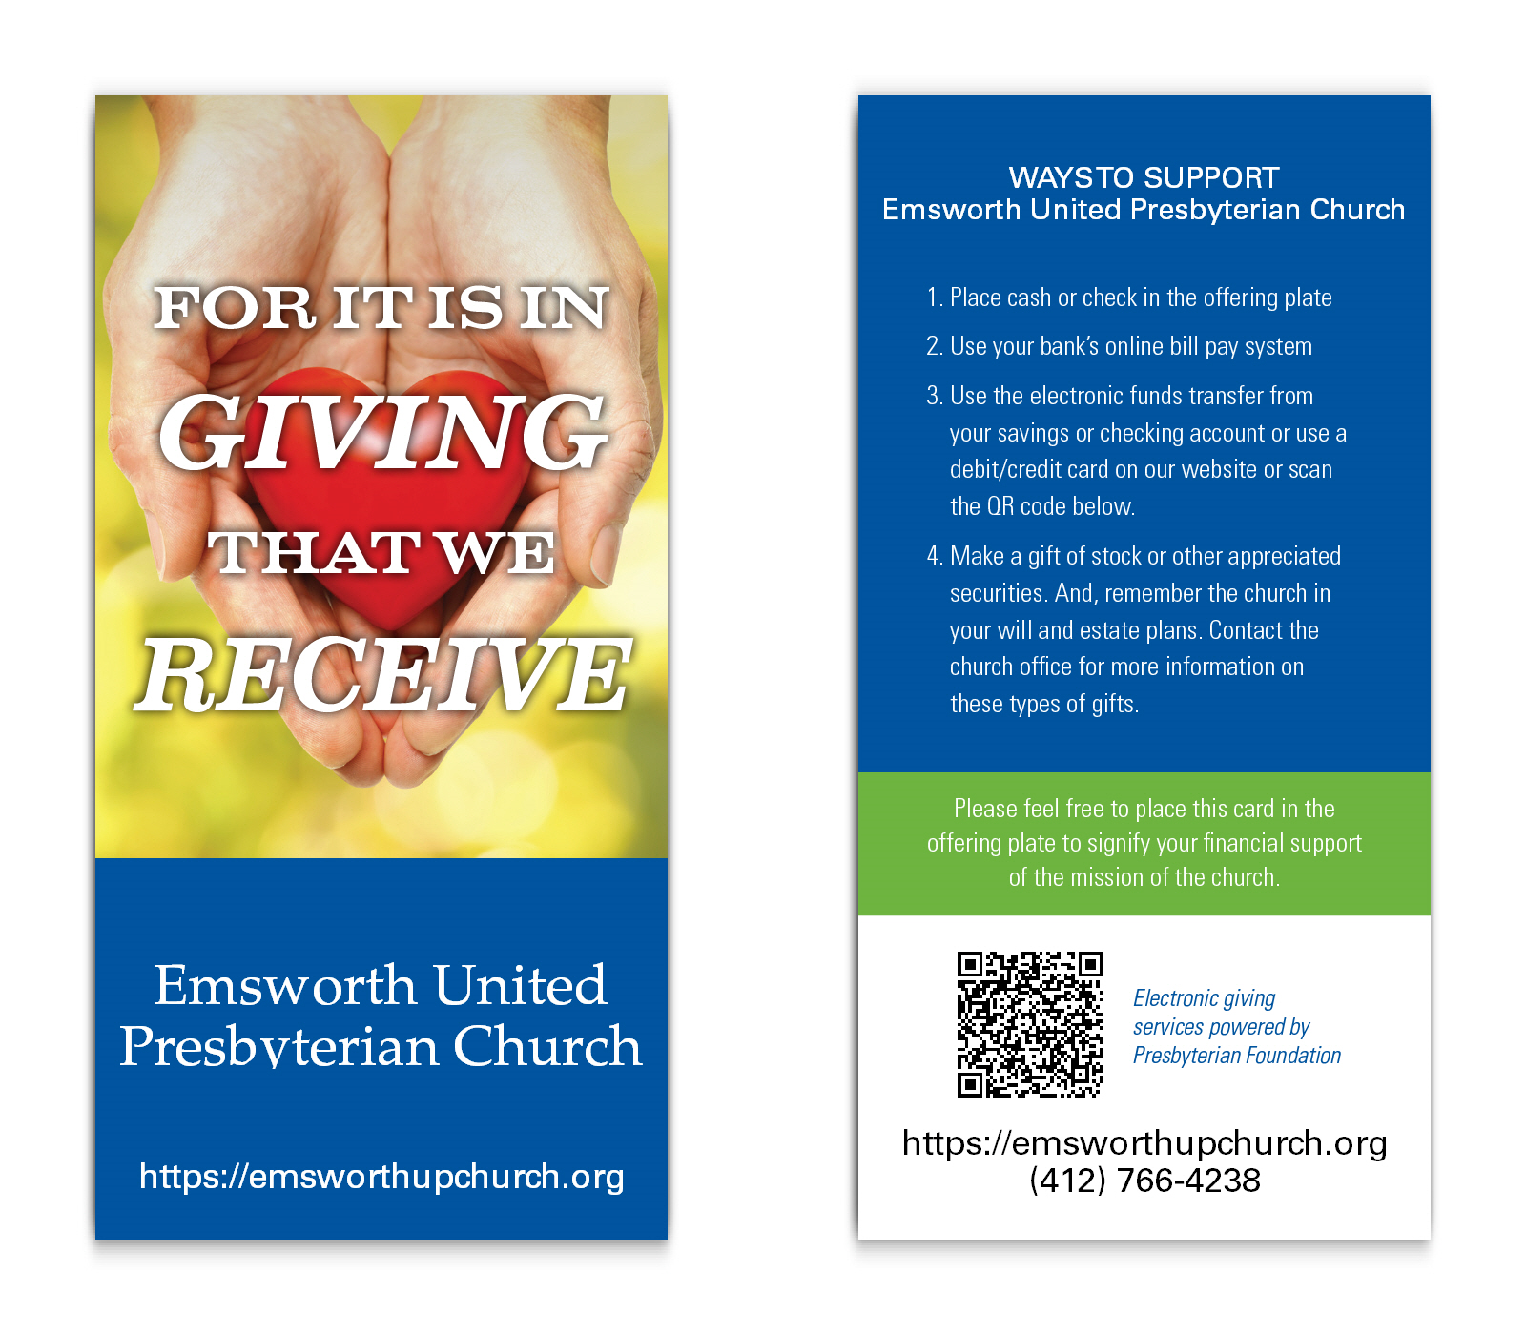
Free Starter Set of 100 Pew Cards

Slide 11

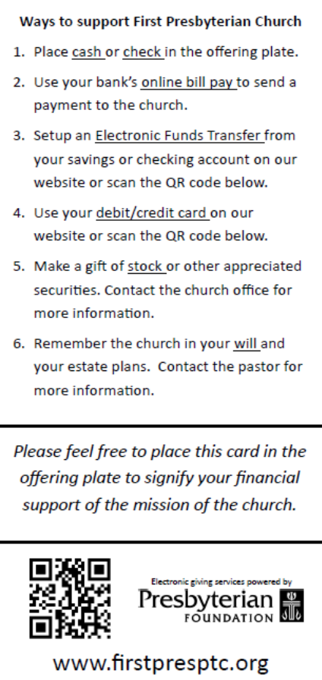
Effective Pew Card

Slide 12

Online Giving Print Resources
https://www.four51.com/UI/Customer.aspx?p=Catalog&CatID=vaBim0SrzOxOPTtWIyZSf9mmOlroLJ-p1yfqVjN9UUuE3NmUuxXtIWA-e-e&CatInteropID=26A55CAE-7DB0-48C3-AD96-7DA6FDA66FC5&CEI=d3c7447c-ff6b-40ae-a81c-c3dc2f9baa00

Slide 13
Questions/Comments
Presbyterian Foundation
The Rev. Ellie Johns-Kelley, Ministry Relations Officer
Ellie.Johns-Kelley@PresbyterianFoundation.org
888-251-8212

